Slide 1
Accounttick
Developed By Highclonoid Softec Pvt Ltd

Slide 2
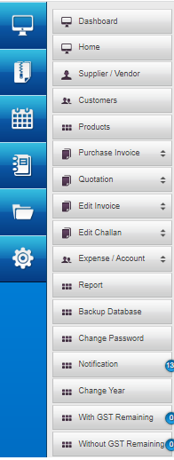
Accounttick Menubar
Supplier/Vendor Adding Process
Customer Adding Process
Product Adding Process
Account And Expense Process
Report Process
Backup Process
Menubar can be customize as per customer requirement

Slide 3
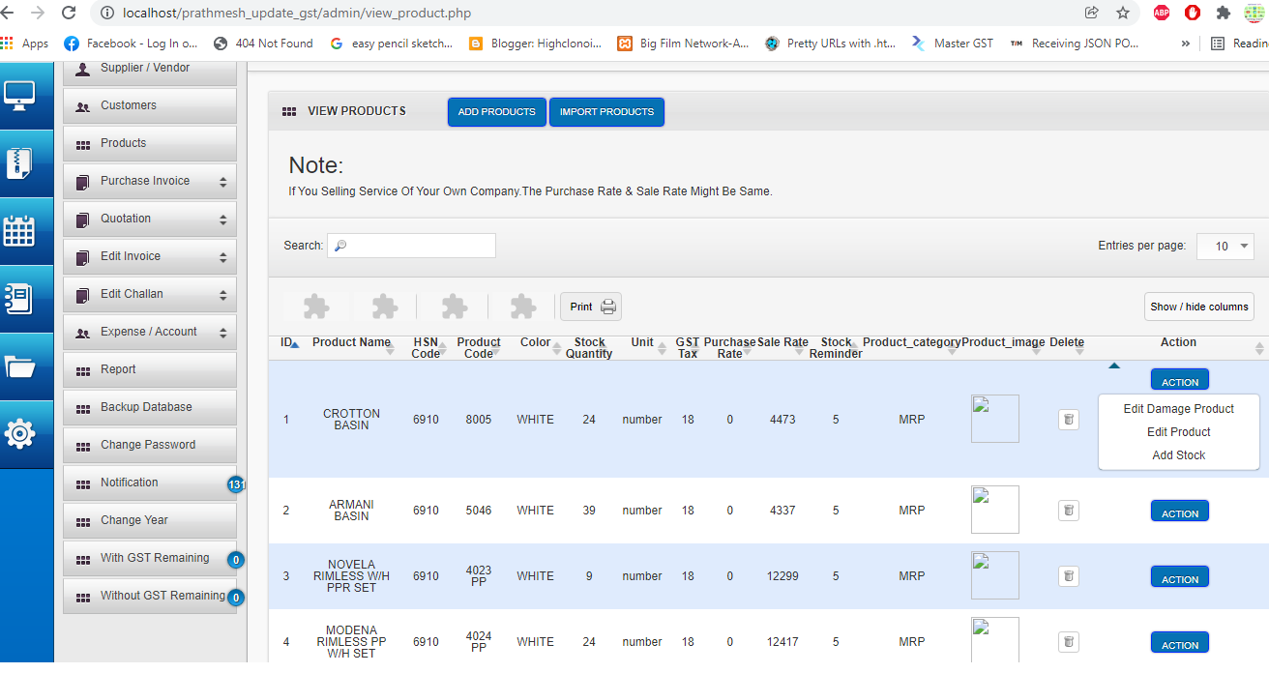
Accounttick Software
Product Option
Accounttick Product Adding Process
1.Product Adding Process
2.Damage Product Process
3.Stock Updating Process
4.Stock Updated by Purchase Invoice Process by vendor
It can be customize as per customer requirement

Slide 4
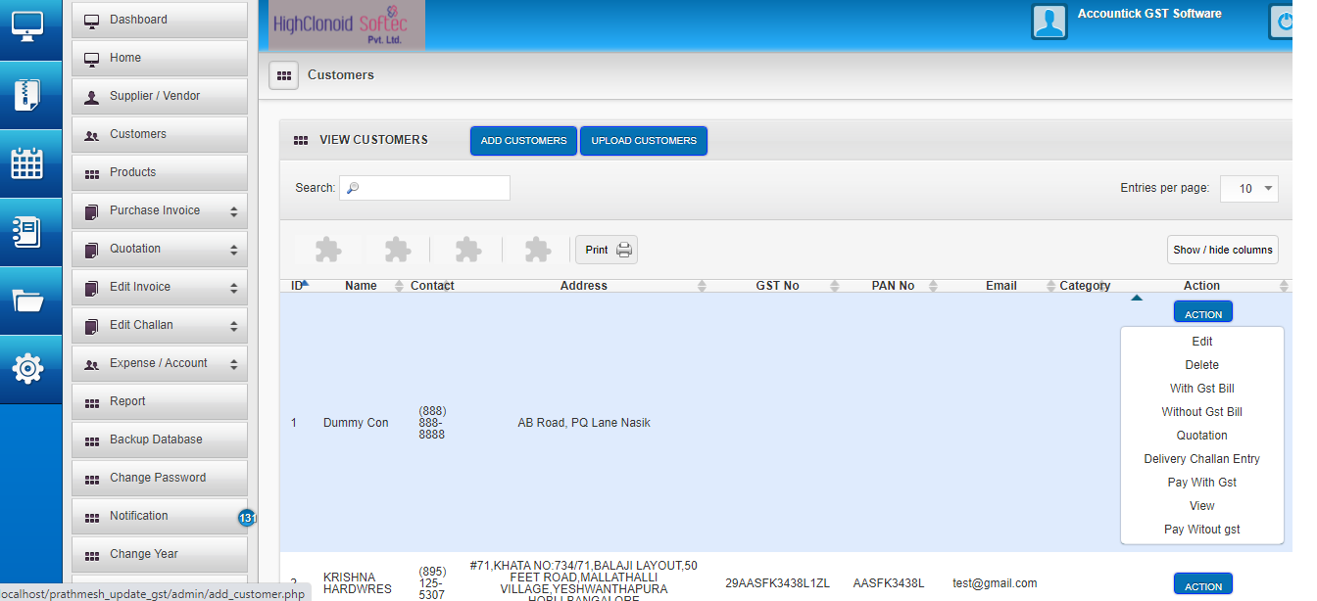
Accounttick Software
Customer Option
Accounttick Software is well arrange with major Option Vendor/Customer/Product For reducing action clicks.
Customer Form has
1.GST Invoicing
2.Reciept
3.Payment Reminder
4.Customer Follow-up
5.Delivery Challan
It can be customize as per customer requirement

Slide 5
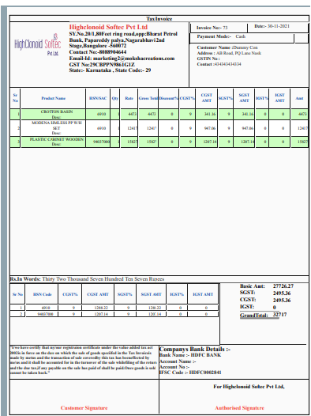
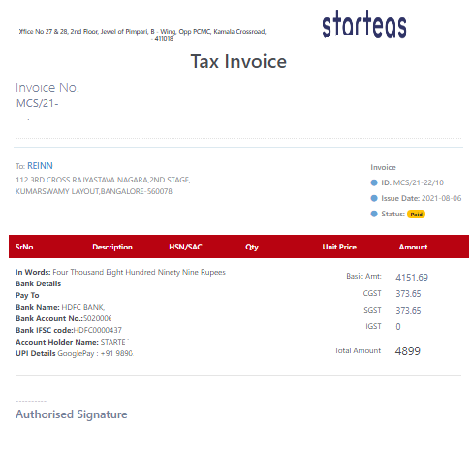
Accounttick Software
Invoicing Bill
Accounttick Invoicing Layout can be customise as per customer Requirement

Slide 6
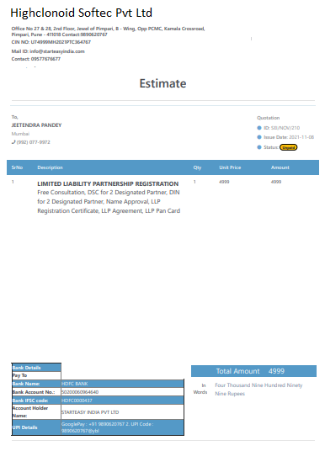
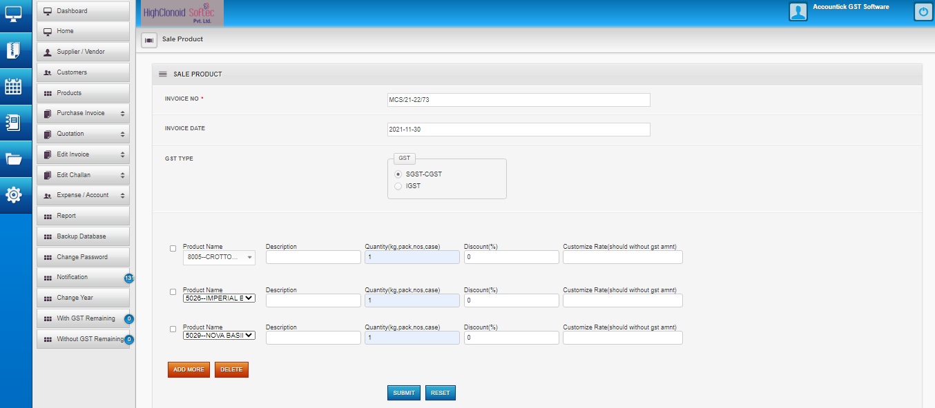
Accounttick Software
Quotation
Accounttick Quotation Layout can be customise as per customer Requirement

Slide 7
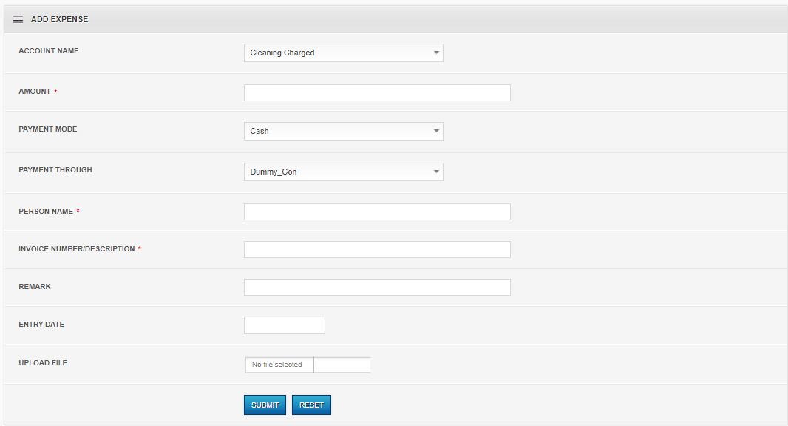
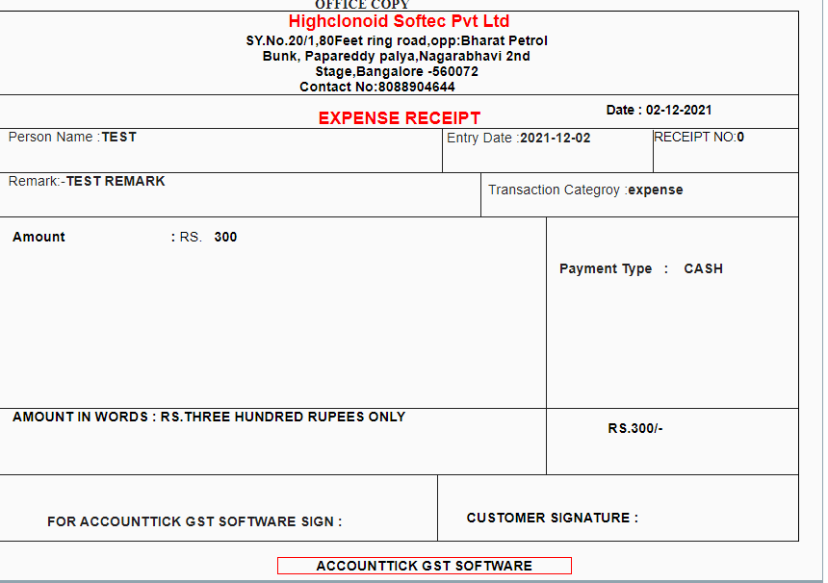
Accounttick Software
Expense And Accounts
Accounttick Reciept Layout can be customise as per customer Requirement

